Slide 1
Social Media Marketing How to make it successful?

Slide 2
What is Social Media
Social interaction and communication through the web
Examples
Social Networking : Facebook, Twitter
Social Video sharing : YouTube
Social Picture sharing : Flickr

Slide 3
Relevance of Social Media
Global Internet population : 2 billion
2/3 of these visit Social Networks
Visiting Social sites is the most popular online activity (even ahead of email and gaming)
Sources:
http://www.internetworldstats.com/stats.htm
Nielsen, Global Faces & Networked Places, 2009

Slide 4
Relevance of Facebook
600 million active Facebook users
Half of these log in every day
48% of 18 to 34 year olds check Facebook as soon as they wake up
28% check Facebook from their phones before they get out of bed
Source : www.onlineschools.org

Slide 5
Relevance of Facebook
More than 30 billion pieces of content shared each month
750 million photos were uploaded on Facebook over New Year’s weekend
Average user has 130 friends
Spends more than 700 minutes per month

Slide 6
Years to Reach 50 million Users
Radio : 38 years
TV : 13 years
Internet : 4 years
iPod : 3 years
Facebook : 200 million users in 1 year

Slide 7
Twitter
190 million total users
100 million new users in 2010
More than 1 billion tweets every month
40 million tweets per day
40% of all tweets come from mobiles

Slide 8
YouTube
4th most popular site
#2 most popular search engine!
20 hours of video are uploaded every minute
15 billion videos are watched every month
Average online viewer watches 12.2 hours of online video each month

Slide 9
Why Social Media?
Conversations – Dialogue vs. traditional monologue
Having a “presence” is not enough
Interact, engage users in conversations
Can be used for
Public Relations
Customer Service
Loyalty-building
Collaboration
Networking
Thought leadership
Customer Acquisition!

Slide 10
Why Social Media?
Our TG is online and spends more and more time online
Ideal platform to connect with them
Brand websites losing relevance
Increasingly, brand conversations are happening on social media
Facebook : 15 million users in India
Twitter : 4 million users in India

Slide 11
Lessons we have learnt
Engage, interact, converse!
Find ways to engage customers offline
Every brand has to become a media brand
Connect with potential partners
Fully integrate social media into your website

Slide 12
Engage, Interact, Converse!

Slide 13
Engage, Interact, Converse!

Slide 14
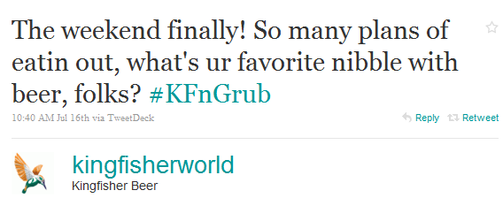
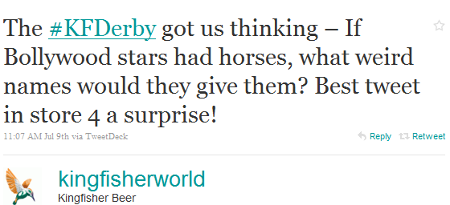
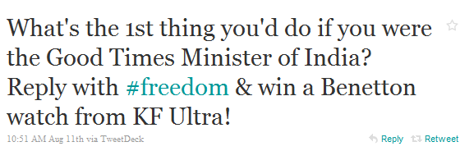
On Twitter

Slide 15
Find ways to engage customers offline
Kingfisher Beer Tweetups : #KFBeerUp

Slide 16
Objectives
Building a direct connect with our Twitter base
Nurture brand advocates
Create unique buzz through a space where most brands have not ventured
Provide a relevant platform for online opinion leaders to meet

Slide 17
Unique Hashtag : #KFBeerUp
Dedicated hashtag #KFBeerUp for the event

Slide 18
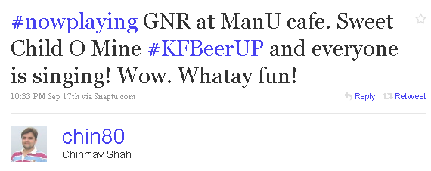
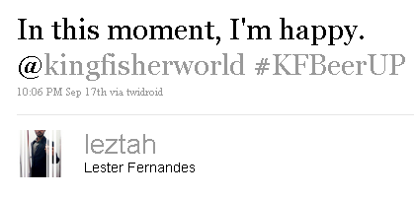
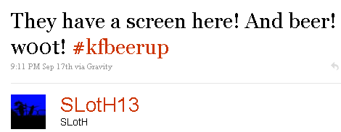
Consumer Speak
During the event

Slide 19
Ford Figo
Digital promotion to celebrate 50,000 Ford Figos
Custom-painted Figo to travel from Chandigarh to Chennai
4 couples, 25 days, 2500 kilometers
Couples selected through online contest
Would update, tweet, facebook, youtube their journey
Fans could follow the tour on
Website : www.drivingford.in
Facebook : http://www.facebook.com/fordfigo
Twitter : http://twitter.com/fordfigo
Supported by online contests for fans
Offline blogger/twitter meetups in major cities along the way
Huge buzz generated online

Slide 20
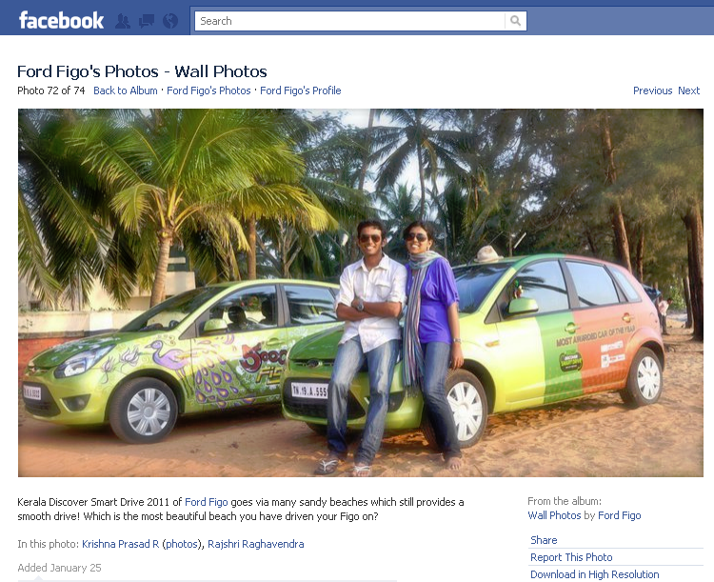
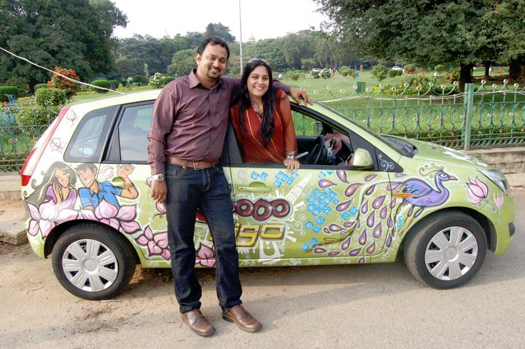
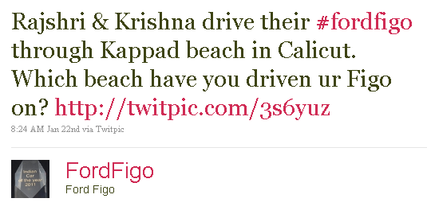
Ford Figo

Slide 21
Every brand has to become a media brand

Slide 22
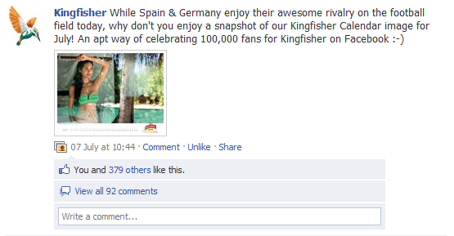
Media Updates

Slide 23
Live coverage of events

Slide 24
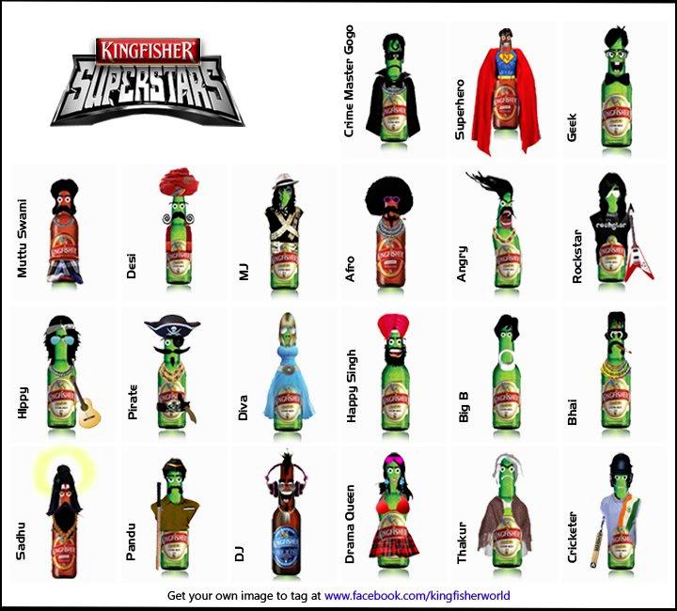
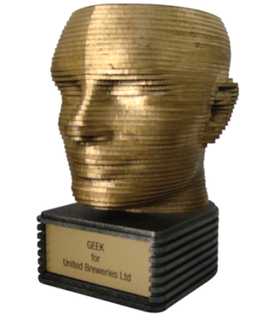
Interactive Media
Facebook tagging “application”
Won Gold (Viral Marketing) at Bangalore Ad Club’s ‘Big Bang Awards’

Slide 25
Connect with potential partners

Slide 26
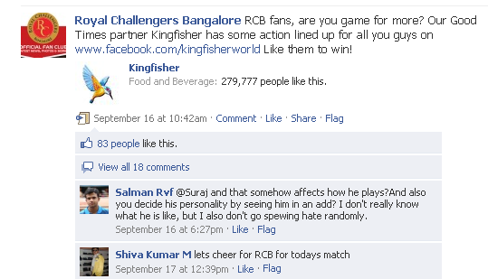
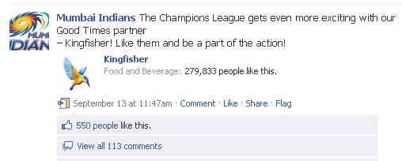
Cross-promotion on partner Facebook pages

Slide 27
Fully Integrate Social Media into your website

Slide 28
Social Media Hub
Social media initiatives by the brand should not exist as separate silos
Can be brought together on brand website and via cross-linking
Kingfisher website also has a social media hub
Collects our social media outposts in one place
Aggregates social content about the brand
Keeps audiences on the website for longer

Slide 30
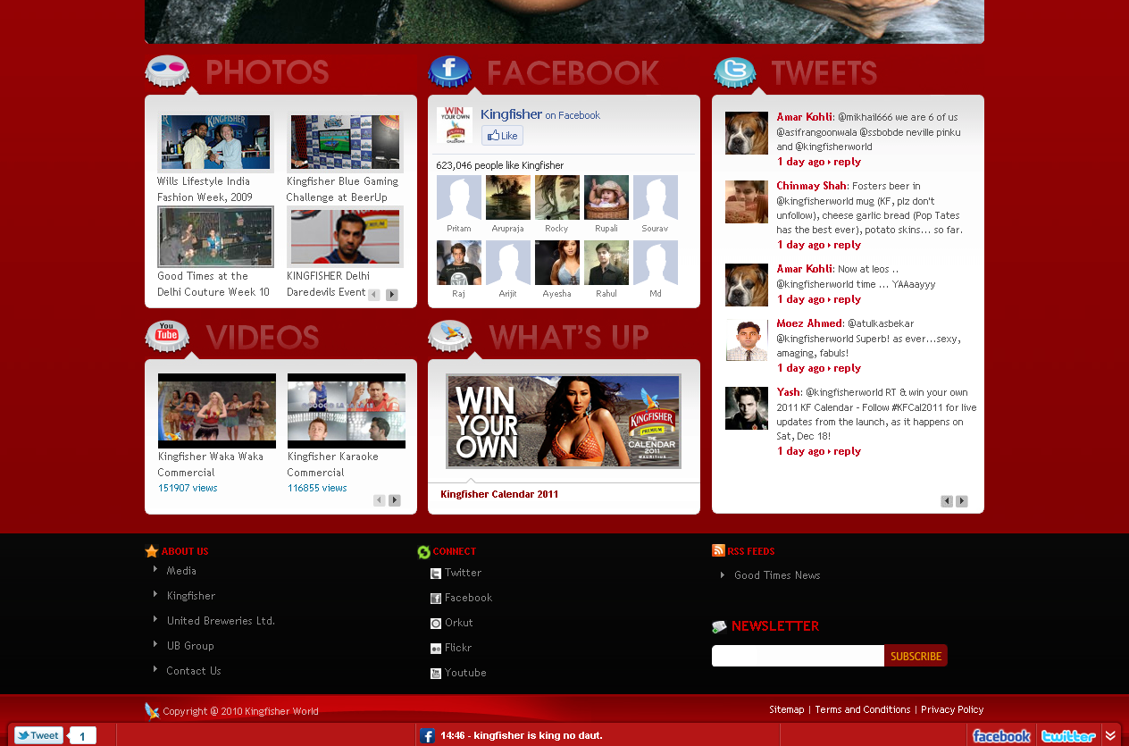

Slide 31
Where are we on Social
Facebook : 750,000 fans
#10 brand in India on Facebook (From: http://socialbrands.media2win.com)
Growing by 4,000 fans a day
500,000 monthly active users
25 million post views per month
Twitter : 6,500 followers
YouTube : 1.5 million video views
Flickr : 1.5 million picture views

Slide 32
Conclusion
Increasing relevance of social media
The future is already here, and it is social
Your brand will be talked about on social media whether you are present there or not
Be there and observe, listen, participate, engage
Find ways to engage your users/consumers offline
Will pay dividends online
Keep audiences continuously engaged with fresh content
Counter short attention spans with relevant/interesting/viral content
There is no silver bullet – trial & error, improve continuously

Slide 33
Thank You

